Slide 1
Corona travel
Detailed design

Slide 2
Product description
Our goal is to allow users to travel online from home via any device of their liking. They'll start by opening an app or a link and choosing a desired destination. After choosing a location, users can choose to view destination in 3D, look at some 3D photos or videos or learn some facts about the place.
Team: Sofya Donskaya, system analyst; Elena Karelina, backend developer; Danil Kireev, frontend developer; Artem Filimonov, backend developer + API integrator
Repo: https://github.com/randomunrandom/corona_travel
Report: https://docs.google.com/presentation/d/19lmSKnWol770kLv_CnQwMoJ-xcEiRje0MoZKP1R9pPU/edit?usp=sharing

Slide 3
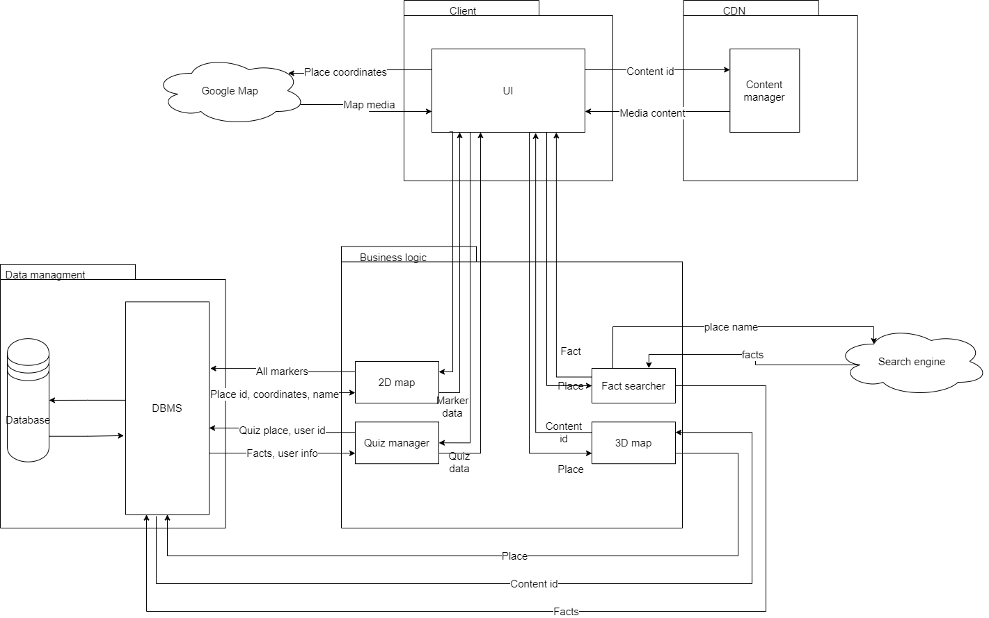
System architecture
Most important principles within our architecture:
Simplicity
Separation of concerns
Don't Repeat Yourself (DRY)
Easy to extend
Weak bounds

Slide 4
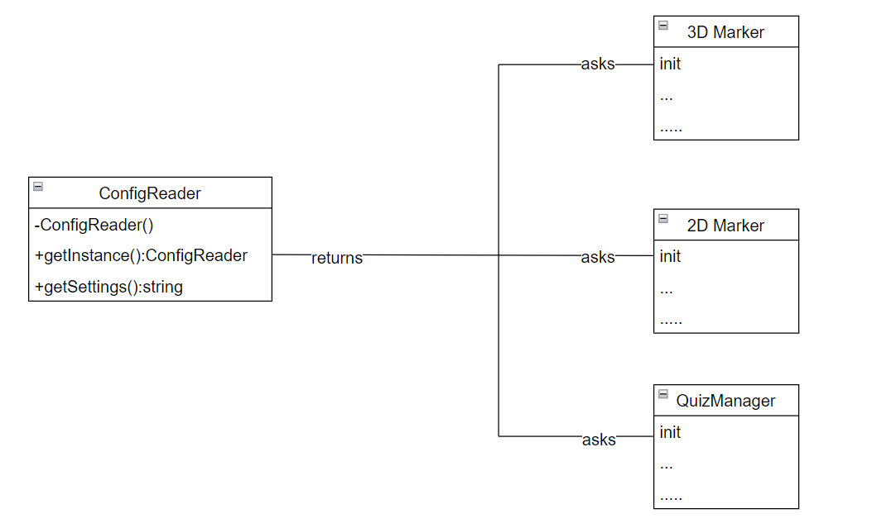
Design case <1> (UML2)
Problem: don’t read settings file multiple times because using file settings is slow
Solution: the class responsible for reading file with settings should be created only once and read file at creation. Use singleton
Notes:
Соня

Slide 5
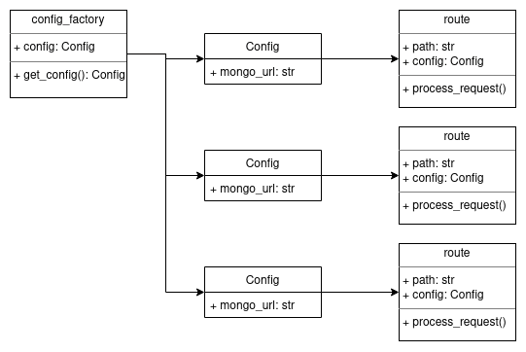
Design case <2> (UML2)
Problem: get settings in routes as dependency to process routes asynchronously
Solution: use factory to create the same config for every route
Notes:
Another design case we want to show revolves around settings in our asynchronous app. The problem is that we need some king of unified settings object, which will store all of the configs: log level, database url and so on. But, since our app is asynchronous, we need to think about threading and how we’ll test this. So, to solve this, we used dependency injection of our Framework, which allows us to insert functions to run before our routes. This function returns settings for routes and can be overwritten for testing. Another possible solution is global object of settings, which could interfere with threading, making routes slow down to read the same object from memory, and would add problems with overriding in testing.

Slide 6
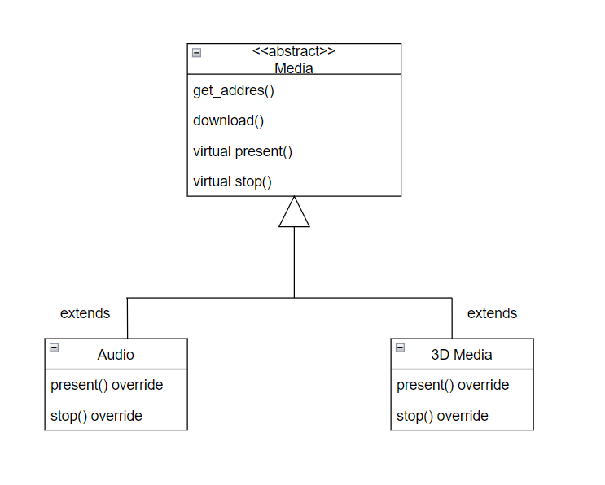
Design case <3> (UML2)
Problem: range of similar actions (but not all) while working with different types of media.
Similar actions: get address by id, download
Different actions: present (display or play), stop presenting
Solution: use template method
Notes:
Лена

Slide 7
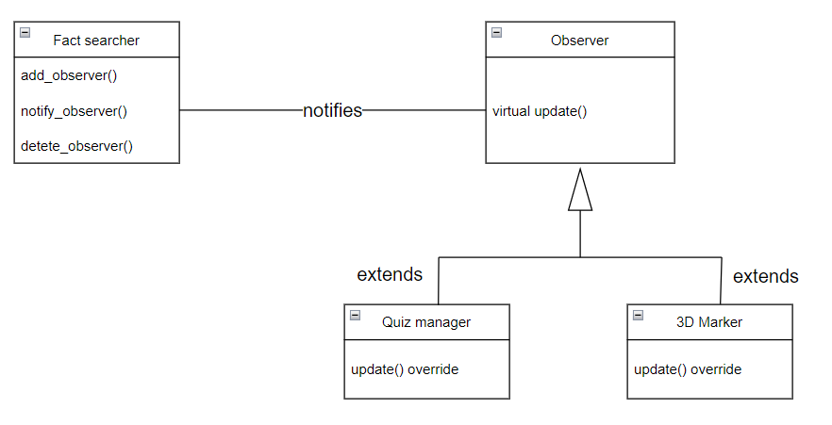
Design case <4> (UML2)
Problem: several classes (quiz, 2D markers) use facts and need to be notified when a new fact is added by fact searcher
Solution: use observer
Notes:
Артём

